Slide 1
Corning-Painted Post
Competition Band

Slide 2
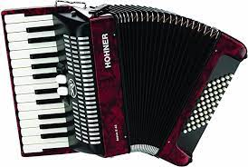
If you need an instrument/piece of equipment
You will receive this at next week’s rehearsal

Slide 3
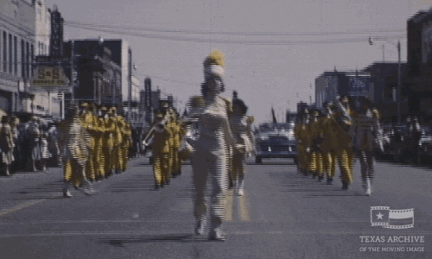
Drum major introduction
Alex Peng, Tristan Lint and Thomas Zhang

Slide 4
What is competition band?
Competition Band is a group of Musical Athletes who perform a show or ‘theme’ to music while telling the story through marching, maneuvering, choreography and theatrics.
Our group competes in the New York State Field Band Conference, Large School II Division

Slide 6
The 2023 Corning-Painted Post Competition Band is pleased to announce our production
entitled: Y2K Musical Selections Inspired by: My Name Is - Eminem Baby One More Time - Britney Spears What's This? - Danny Elfman My Heart Will Go On - Celine Dion It's the End of the World As We Know It - R.E.M. Requium, Dies Irae - Giuseppi Verdi

Slide 8
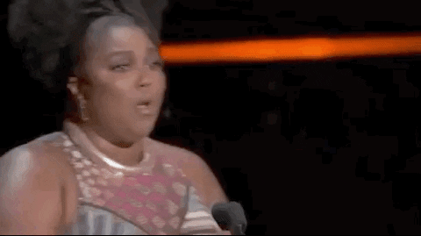
LET’S GOOOOO!!
Let’s have fun creating and writing this story together
This is a show about emoting and projecting both a different era, and a sense of fear.
We will be asking you to do things that is out of your comfort zone!

Slide 9
How are the bands ranked?
The Bands are judged out of a total score of 100
There are 6 judges and ‘Captions’
The captions are Field Music (10), Field Visual (10), Ensemble Music (20), Ensemble Visual (20), Music Effect (20) and Visual Effect (20)

Slide 10
Band staff
Director – Mr. Joseph Stork
Assistant Director – Mr. Timothy Allen
Music Arrangers – Mr. Joseph Stork and Mr. Timothy Allen
Drill Designer – Mr. Rick Morey
Winds/Visual Staff –Mr. Spencer Blumenfeld, Mr. Tyler Palm and Mr. Donald Allen
Visual Staff –Color Guard Staff – Kira Farley (Caption Head) and Sarah Dickerman
Percussion Staff – Mr. Tim Gallagher (Caption Head), Mr. Benjamin St Clair, Mr. Benjamin Wigley, Mr. Jonathan Wolter and Mr. Adam Price

Slide 11
Weeknight rehearsals
First Rehearsals
Section Leaders and Rookies– 6-7:30pm, 7/12
(Leadership team report @ 5:15)
Full Band – 6-8:30pm, 7/19
July – August: 6-8:30
September: 5:30-8
October: 5:30-8:30
The schedule as it is today may change. Rehearsals are mandatory but if you/your student needs to miss, please tell Mr. Stork

Slide 12
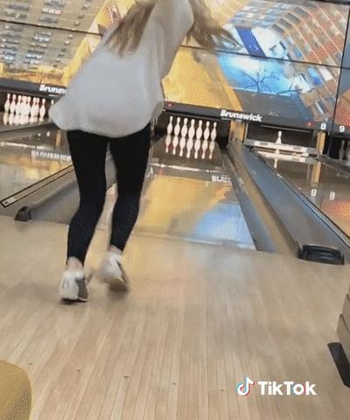
Comp band bowl-a-thon!!
August 2nd or 3rd– 6-8 @Crystal Lanes
$15 a person, includes Shoe, 2 games, and Pizza and Pop
As always, if your student can’t afford this, the Boosters will cover the expense ☺

Slide 13
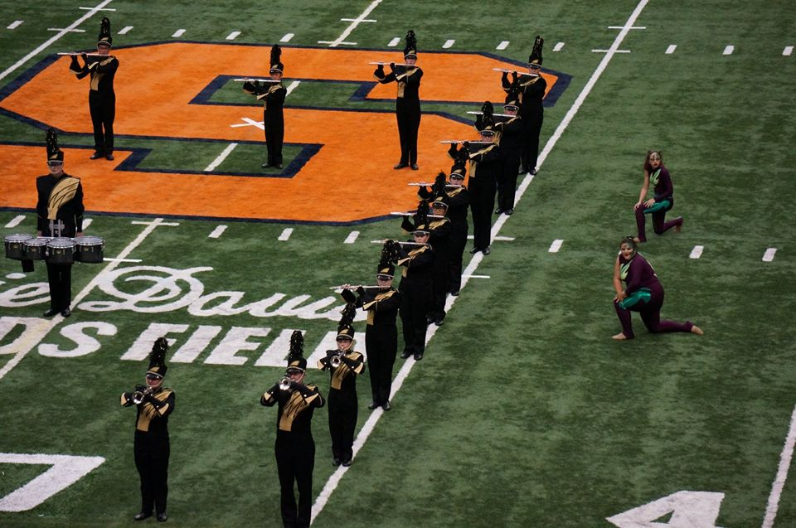
Band camp
Week 1 (8/7 – 8/10)
Monday through Thursday*
Located at CPPHS
Rehearse 12-5, 6-8:30 *12-4:30 only, 8/4
8/4, 12-4:30 then section bonding after
Dinner 5-6 (on your own)
Week 2 (8/14 – 8/18)
Monday through Friday
Located at CPPHS
Seniors Hand in your Senior Bio/Pics on 8/15
Rehearse 9-12, 1-4:30, 6-8:30
Lunch, 12-1, Dinner 4:30-6 (Free Breakfast and Lunch may be available, Dinner on your own)
Comp Band BBQ, Friday, 8/18 @5pm, CPPHS

Slide 14
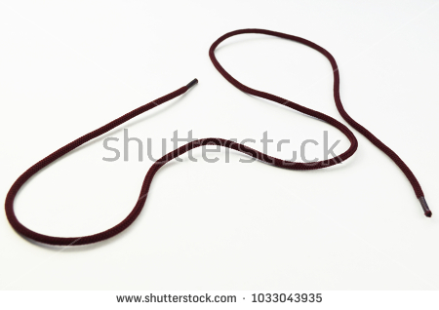
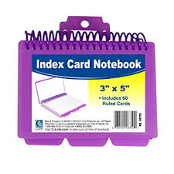
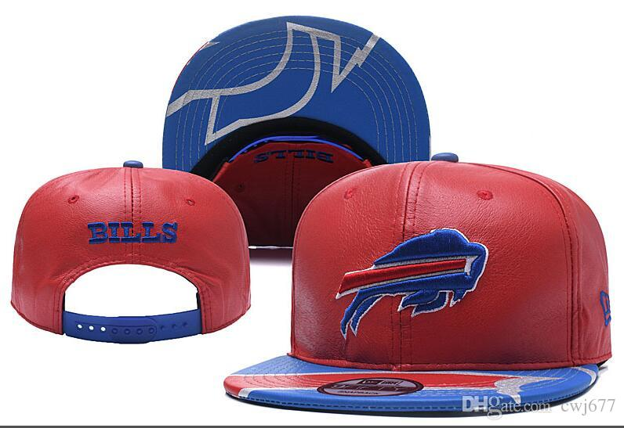
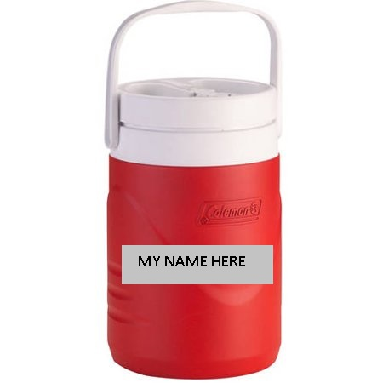
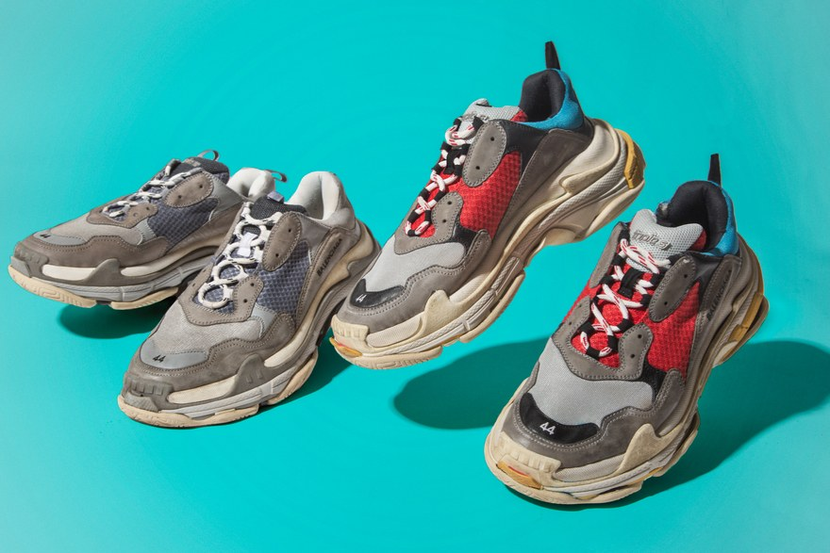
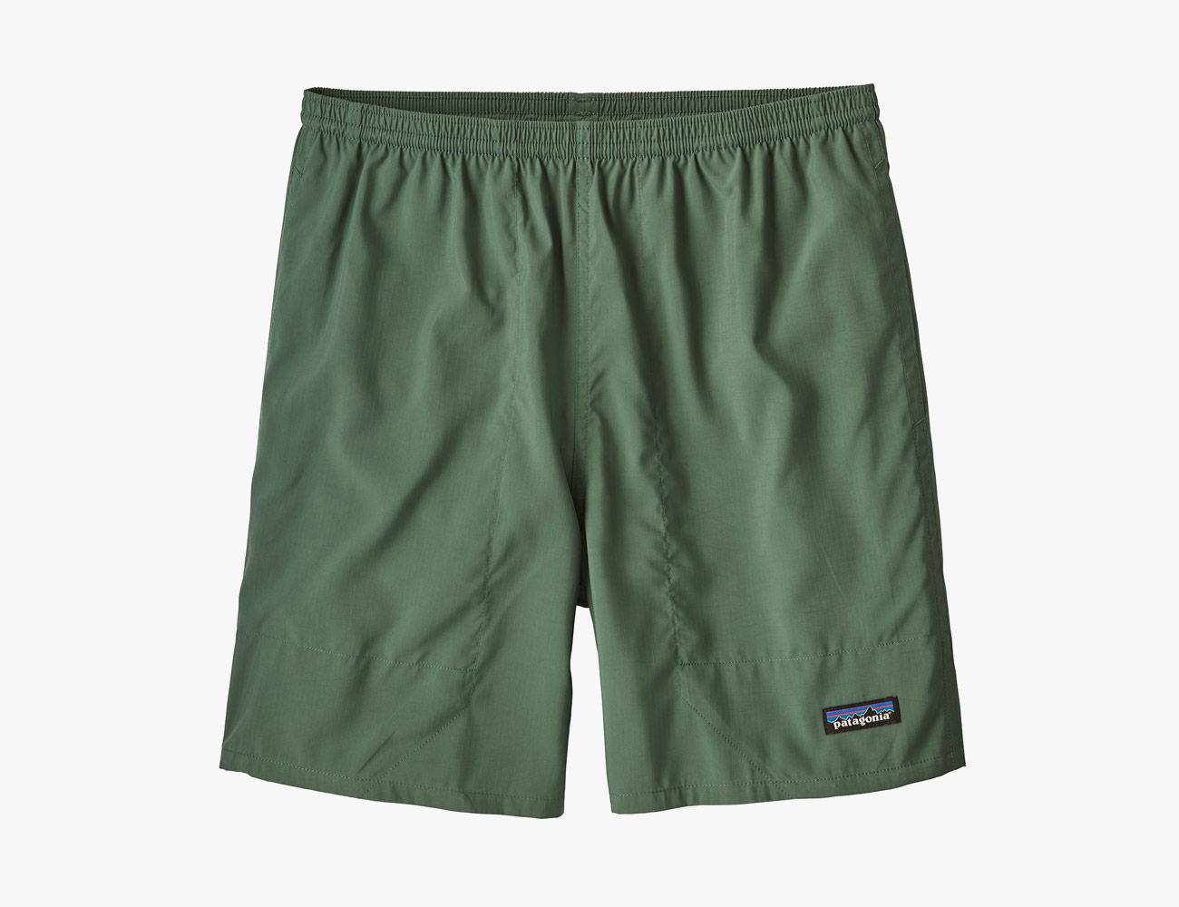
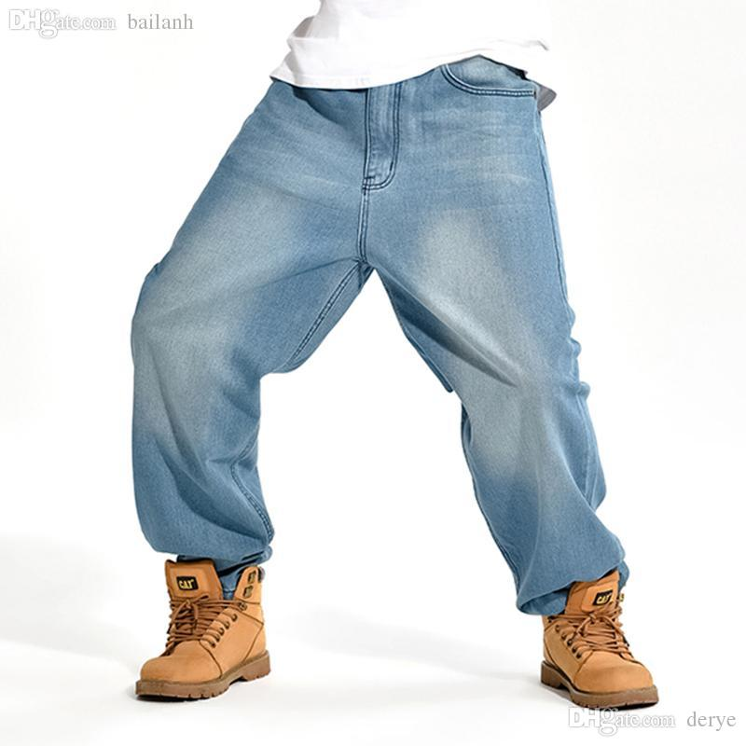
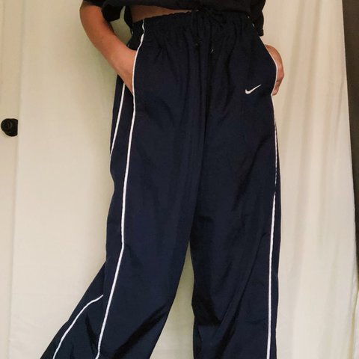
What does my student need for band camp?
Athletic Shoes*
Athletic Wear (Shorts, T-Shirt)***
Sunscreen
Hat*
Jacket/Extra Socks in case of inclement weather (Dress in layers)
Index Card Notebook (DotBook)**
Pencil
Food Plan (dinner for the 1st week, Lunch and Dinner for the 2nd week)
Transportation
Water Jug of Sorts*

Slide 15
Week 2 spirit days/section competition TBD
Monday – Olympic Color Day/Section Bonding-Band Story Time
Tuesday – Section Shirt Day/Create a performance
Wednesday – Sports Ball Day/Nitro Ball Tournament
Thursday – Country Colors Day/March Off
Friday – Hawks Band Shirt Day!

Slide 16
Band Camp BBQ
Friday, August 18th @ 5pm
Corning Memorial Stadium
5:00 – Clinic/Show and tell
5:15 – First public Performance of our 2022 Show ‘Slightly Off Kilter’
5:30 – BBQ/Fun time!
The main course and supplies will be provided but we’re asking for families to bring something if they can.
Freshman Boys – Drinks
Freshman Girls - Chips
Sophomores – Desserts
Juniors – Salad/Side Dish
Seniors – Salad/Side Dish
We will need parent volunteers to help get things set up while the kids are still practicing that afternoon. If you can, set-up and grilling will begin at 4pm! Parents, please come and support your students.
If you are not on our email list, please email Mr. Stork: Jstork@cppasd.com
Thanks for all you do!!!!!!!!!!!

Slide 17
$$$
Students will need Money for Shoes ($36) and tape if necessary
Students will need money for bowling ($15)
Students will need to cover their trip to our USBands National Competition (~$250)
If you ever need any financial support, please express this, we do not want students to not participate for any reason!

Slide 18
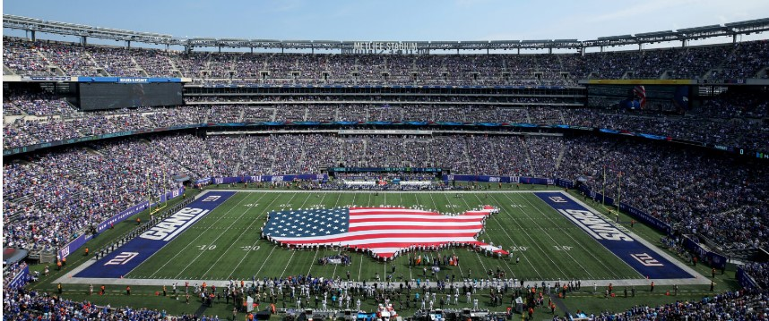
USBands National Championship
JRHS Area All State Conflict, we can get you into another district ☺

Slide 19
Sports and band
Band | Sports | Result
Rehearsal | Practice | Split rehearsals and practices.
Rehearsal | Game | Good luck at your game!
Performance | Practice | See you at the performance.
Performance | Game | Communicate with the director and your coach. A combination of these two teachers and your family will decide.

Slide 20
Communication
Website
DeCapo
Facebook
Instagram
Remind
Section Leader Group Messages
Google Classroom

Slide 21
www.cppbands.org
www.cppbands.org/competition-band
Schedule is on here via Google Calendar, Sync it with your phone!
You will be able to find schedules, music, drill, scores, Chaperone Sign Ups, Fundraising, Trip Info, etc…
If you need it, you can find it here

Slide 22
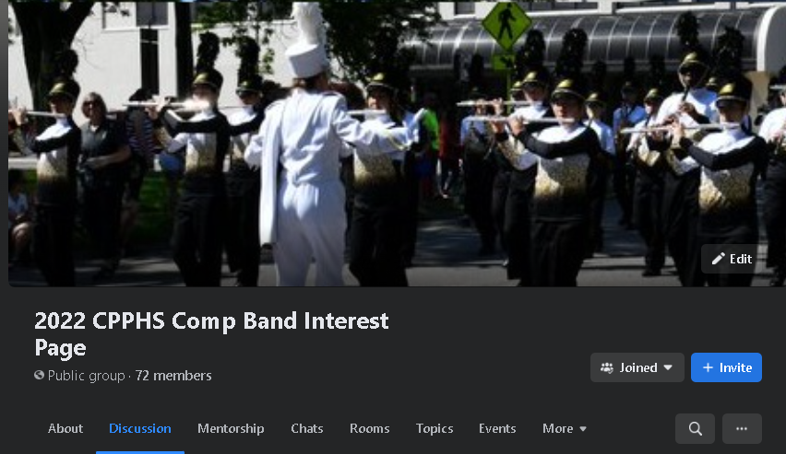
Facebook page
2023 Competition Band Interest Page
To add yourself, ask a member. You can request to join. The link is on our website
Go way for family and friends to follow the season.

Slide 23
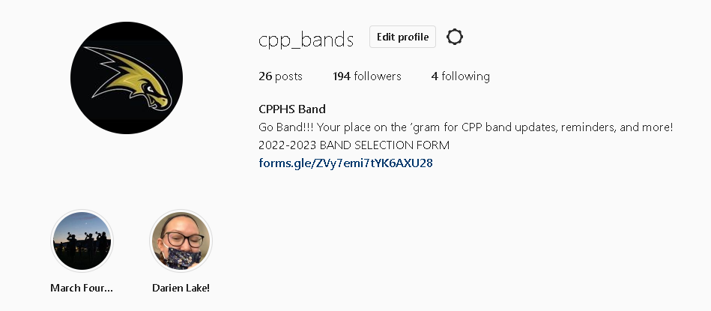
Instagram
Band Instagram - @cpp_bands

Slide 24
Remind
Go to remind.com/join
Enter the class code: cppcomp23
Enter you first and last name along with your mobile phone number or email address.
Click Sign up.

Slide 25
Section leader group messages
If you haven’t already, make sure to accept your section leaders request to add you to the group message.

Slide 26
CPP Band boosters
Next meeting: Tomorrow!!!, 7/6 @7pm
President – Brett Nordman
Vice President – George Kaufmann
Co-Treasurer – Erika Lakota
Co-Treasurer – Brenda Frost
Secretary – Crystal Kochersberger

Slide 27
How can you help???
We are in need of parents to help build props this year! If you are available during either of the band camp weeks, please donate some time
Can you sew? We have a project for you then ☺
We need parents to chaperone
We need parents to help move equipment to and from contests
We need some parents to help put together the Comp Band BBQ (last day of band camp) and we also need cups for the students to drink from at Band Camp
Sign up on the band’s website, under Competition Band
We need a new water caption head!!!

Slide 28
July 25th Chaperone Meeting 7:15pm, @CPPHS, C110
Difference between Chaperone and Booster
Make a plan and build/order!!
Sign up on the Website (show)

Slide 29
Home Show ads
See in the packet and on the website

Slide 30
August 9th Home show planning meeting 6:30pm, @CPPHS, C110
Crystal City Competition 9/23
Bandtoberfest 10/21
WGI Winter Guard Regional 2/16-17
Jazzapalooza?
Twirling Unlimited NYS Regional Early July

Slide 31
family

Slide 32
Mock show day schedule
Competition Band Vestal Show
8:45 – 12 Rehearsal Block
12-12:45 Lunch on your own
12:45 – 3 Rehearsal Block
3-3:30 Load truck/buses
3:30 Depart for Vestal HS, 116 Clayton Avenue, Vestal, NY ***Please pack a light snack and water for the bus***
5-5:10 Arrive, unload, restrooms
5:15 – 5:45 Sectionals, Percussion Warms Up where ensemble will be
5:50- 6 Ensemble Run Through (show starts at 6)
6-6:15 Travel to the gate
6:15 Gate time
6:26 GAME TIME, after the performance, students will be allowed to visit the concession stands and watch the remaining performances. Please bring an appropriate amount of money for concessions if desired.
8:45 Retreat
9:30 Estimated Departure Time
11pm Estimated Arrival Time, Corning HS

Slide 33
Next Rehearsals
7/12, Section Leaders and Rookies, 6-7:30 @CPPHS
7/19, Full Band, 6-8:30 @CPPHS

Slide 34
Keep your chin up
This will be hard, but it will be A LOT of fun and a life changing experience
Keep making music
Keep spinning
Keep smiling
Keep communicating
You’re not in this alone!

Slide 35
Things you can’t control vs things you can
Can’t
Can
Your talent
Your Height
Another group’s success
The weather
Sometimes you will be frustrated
Being tired
The Pandemic
How you receive/apply information
Your commitment to mental and physical fitness and hygiene
Your personal preparation
Leaving with enough time to get to rehearsal safely and timely
Your body language
Bringing mental energy
Your hygiene and attentiveness

Slide 36
Your students’ physical and mental health are our program’s priority. Advocate and promote self advocacy. If you see something, say something.

Slide 37
Leadership team please come up
At the end, break into brief sectionals just to establish a connection/communication

Slide 38
Questions/things I missed?
Oh and remember, to be early is to be on time, to be on time is to be late, and to be late is unacceptable ☺
Please plan on having your students at practices at least 15 minutes ahead of time
Conflicts will happen, communicate them!
Email any questions! jstork@cppasd.com
Open floor for dialogue

Slide 39
This Power Point will be available on our website for reference ☺

