Slide 1
Canada Band Trip Information Night
Monday, August 20, 2018

Slide 2
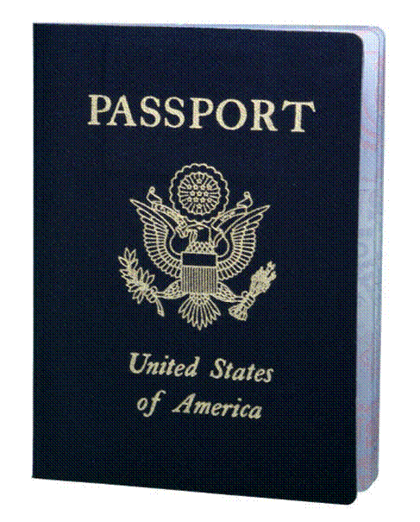
Adults will need a Passport or Passport Card (enhanced license) and proof of identity
CROSSING THE BORDER
If you do not have one, you should apply for one immediately! You must provide proof of passport or pass card two weeks prior to our departure.
Students age 18 and under
will need an original or certified birth certificate or a passport if they already have one and a completed permission form on the School District letterhead. These will be collected two weeks prior to our departure.

Slide 3
Payment Collections
$100 Deposit – PAST DUE!
August 31, 2018 - $250.00
Final payment date is due September 15th
Withdrawals and Refunds
Band Boosters are obligated by a contract. By signing the Commitment Letter parents and students made an obligation. All payments are non-refundable, no refunds will be issued.

Slide 4
Fundraisers that can be credited to Payments
Fundraiser | Leader | Dates | Profit per Unit | Potential Sales or units | Potential Profit
NASCAR at the Glen |  | August 4th & 5th | $7 | 5 hours | $35
Show Program Ad Sales | Ron Beck | Due by August 31st |  | Full Page Ad | $50
Krispy Kreme Donuts | The Changs | Aug. 27 – Sept. 10 | $4 | Dozen/half dozen | $40
Coffee & Tea | Need a Leader | TBD | $5 | Bag | $50

Slide 5
Medical Release Forms & Physician Orders
Every student must have a Commitment Letter which includes the medical release form completed and turned in immediately.
Blank copies online
Any student who will be traveling with a medication must have the Physician’s Orders completed and turned in to the School Nurse or Main Office. These are also online.
If the school nurse already has a current form for the 2018-2019 school year on file, you do not need to complete again

Slide 6
Charms Office Assistant
http://www.charmsoffice.com
If you are not receiving emails and notifications from the Band Boosters and the Band Directors see Mr. Stork to make sure we have your information.
This is the best way to stay up to date on band events.

Slide 7
www.cppbands.com
You are here ☺
This is where you’ll find up to date files

Slide 8
Packing List What to Bring
Don’t overdo it!!!
Band t-shirt & band shoes
Warm clothes and jacket
Temperature in Canada
Average Low 46F
Average High 59F
Layers are the answer
Light waterproof jacket
Check the itinerary to determine the best clothing options for the day
Comfortable walking shoes
Money for meals not included and souvenirs
Breakfast and lunch for the first day
Medications if needed

Slide 9
Meals
Saturday, October 6th
Students should bring a breakfast snack and a brown bag lunch
Dinner will be provided on the Dance Cruise
Sunday, October 7th
Breakfast is included at the hotel
Students will receive $10 in lunch money to use while at the zoo
Dinner will be provided during the Dinner Theatre
Monday, October 8th
Breakfast is included at the hotel
Packed lunch provided at the parade
Dinner provided at the Rainforest Cafe

Slide 10
Itinerary Changes
Dinner Cruise food was adjusted by the cruise company
Sunday lunch is now $10 allowance to make purchase at the zoo instead of a buffet lunch at the Hot House Restaurant
Sunday matinee performance of Come From Away has been removed, the afternoon will be at Clifton Hill and the evening will be the Greg Frewin Dinner Theatre
Monday Rainforest Café dinner is now a dinner selection instead of a buffet
Specific Hotel sites are included

Slide 11
Roommate Signups & Dinner Selection
Available outside the band suite
All students must make their selections on or before August 27, 2018

